Slide 1

This course was developed as a part of the VLIR-UOS Cross-Cutting projects:
Statistics: 2011-2016, 2017.
Statistics: 2017.
Statistics for development : 2018-2022.
The >eR-BioStat ITP: 2024-2026.

Slide 2







Short course in Hanoi:
Introduction to inference using R:
Continuous variable in (one population)
The >eR-Biostat initiative
Making R based education materials in statistics accessible for all
Developed by
Thi Huyen Nguyen and Ziv Shkedy
(Hasselt Univesrsity, Belgium
ER-BioStat
https://github.com/eR-Biostat
@erbiostat

Slide 3
Course structure
10:00-12:00
  Introduction: steps in data analysis
  Analysis of numerical data: point estimators and interval estimates
  Visualization tool
  Interval estimates.
  Reporting.
  Inference for numerical data for one population
12:00-14:00: Lunch break
14:00-15:30
  Inference for numerical data for one/two population(s)
  Reporting.
15:30-15:45 Break.
15:45-16:30
  Inference for numerical data for one/two population(s)
  Questions and discussion.

Slide 4
Steps in data analysis

Slide 5
Steps in data analysis
Data analysis approach in the course:
A Problem
A data analysis Problem
Scientific problem of interest.
Data driven decision
Notes:
think of.

Slide 6
Steps in data analysis
Steps related to data analysis:
Data collection
Data Understanding
Data Preparation
Data analysis (1)
Exploratory data analysis
Data analysis(2) Modeling. Inference.
Simulation.
Communication
Identify project objectives
Collect and review data
Select and cleanse data
Manipulate data and draw conclusions
Evaluate model and conclusions
Apply conclusions to business
Not a part of our course
Notes:
think of.

Slide 7
Steps in data analysis
Estimating the mean BMI in the population.
Exploratory data analysis
Data analysis, modeling, inference
Communication
Scientific problem of interest: how to estimate the mean BMI?
Methodology: inference for one sample:
Point estimates.
Interval estimates.
Hypothesis testing.
A report.
The solution
Notes:
think of.

Slide 8
Steps in data analysis
Estimating the mean BMI in the population.
Exploratory data analysis
Data analysis, modeling, inference
Communication
Scientific problem of interest: how to model the association ?
Histogram, Boxplot…
Confidence intervals and test of hypothesis.
A report.
Methodology: inference for one sample.
The solution
Notes:
think of.

Slide 9
Steps in data analysis
Estimating the mean BMI in the population.
Exploratory data analysis
Data analysis, modeling, inference
Communication
Scientific problem of interest: how to estimate the mean BMI?
Histogram, Boxplot…
Confidence intervals and test of hypothesis.
A report.
Methodology: inference for one sample.
ggplot2()
z.test ()
R markdown to produce a HTML file.
We “translate” the methodology to software usage
We develop software to produce the solution and to communicate the solution
Notes:
think of.

Slide 10
Course materials

Slide 11
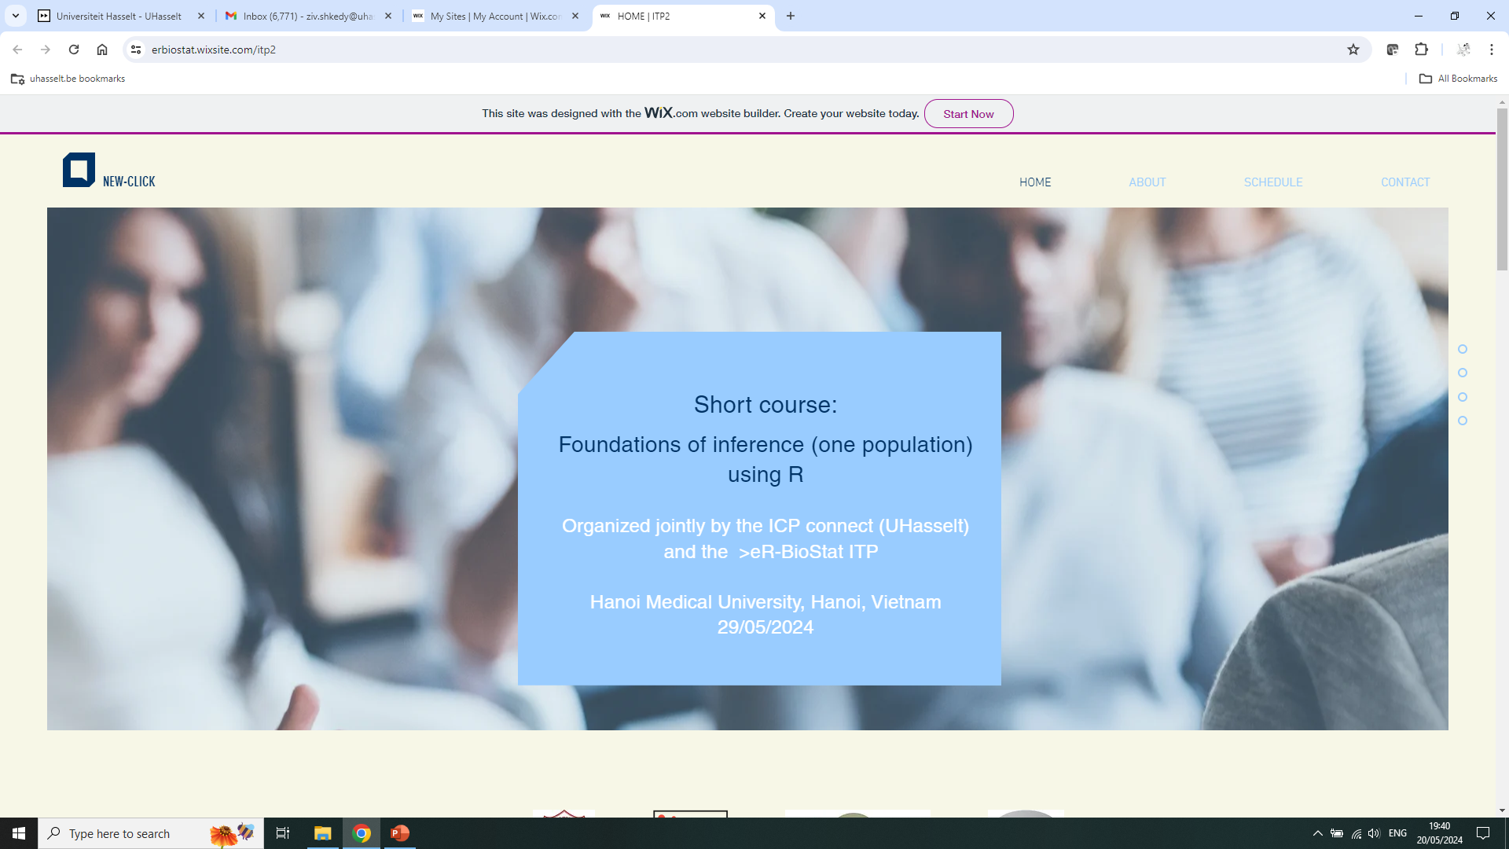
Course’s website
https://erbiostat.wixsite.com/itp2

Slide 12
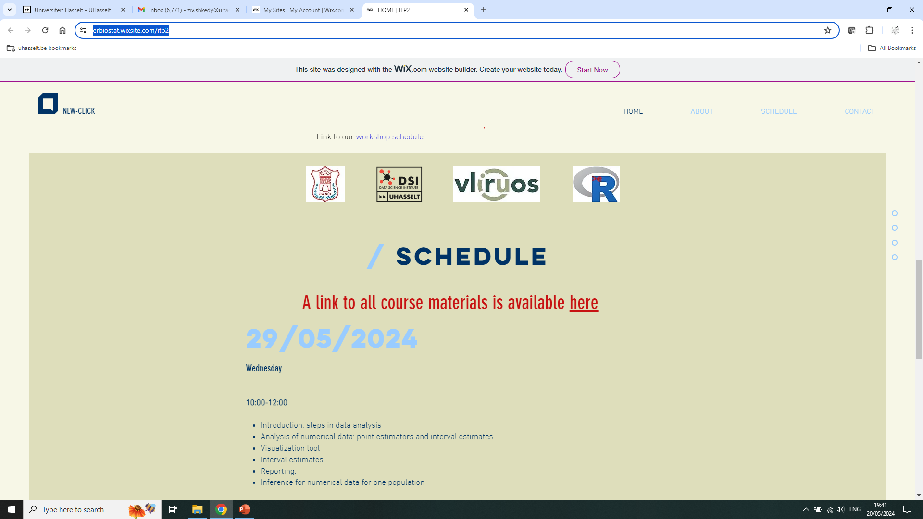
Course’s website
Link to the course materials:

Slide 13
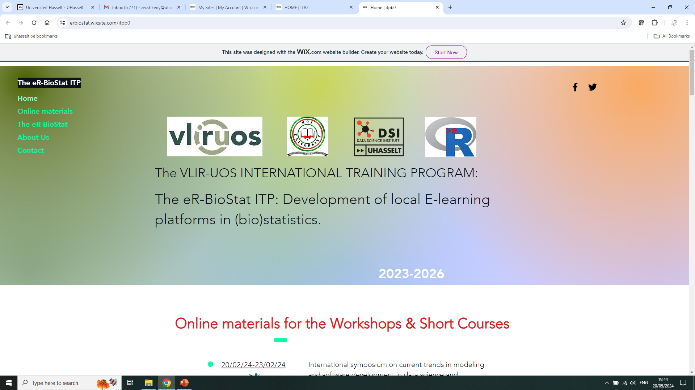
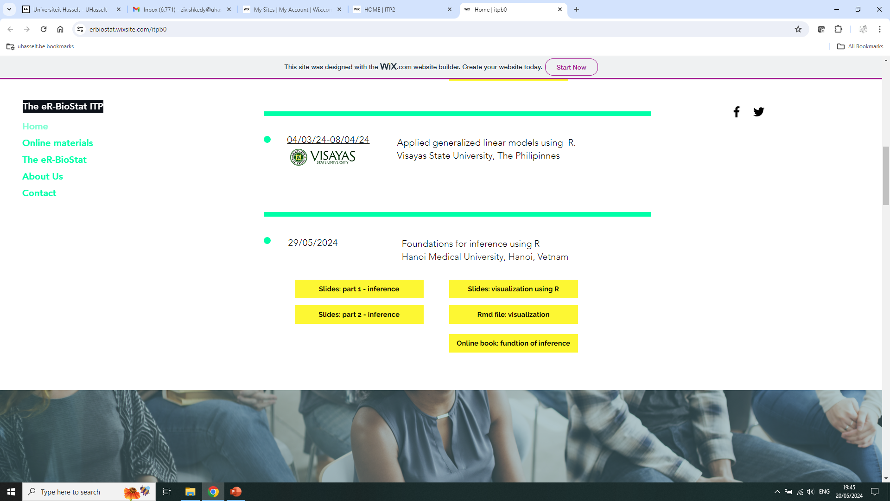
Course’s website
https://erbiostat.wixsite.com/itpb0
Course materials online include:
  Online book.
  Slides.
  Rmd files + programs for the examples.

Slide 14
Course’s website
https://erbiostat.wixsite.com/itpb0
Data analysis.
Visualization (=how to make nice plots).
Output production (=how to produce a nice and easy report).

Slide 15
Steps in data analysis
Exploratory data analysis
Data analysis, modeling, inference
Communication
How to present
The data=visualization.
How to analyze the data=methodology
Output production
Notes:
think of.

Slide 16
Steps in data analysis
Exploratory data analysis
Data analysis, modeling, inference
Communication
How to present
The data=visualization.
How to analyze the data=methodology
Output production
Software
Notes:
think of.

Slide 17
Software

Slide 18
Software
All examples: illustrated in R.
You need to install:
  R.
  R-Studio.
R packages for the course:
  R markdown.
  z.test().
  ggplot2.
  …

